Slide 1


Engage
Welcome to the first …
Members only quarterly meetings!
Connect
Annual Celebration & Member Awards!
Network
Inform
Join us for our annual celebration during the Q3 Quarterly Meeting.
Wed., September 1, 2021
Carolina Stables, Siler City, NC
Further details will follow as we near the event date.
What if I can’t attend?
Virtual & live events will be recorded. Our future live events will have a virtual option.
Meeting Format
Stay informed!
Virtual meeting & networking activities to be built in until we move to live events. Socializing and networking time before and after our live events!
Updates on ACMP Carolinas Chapter, accomplishments, & industry trends
2021 Meeting Dates
Wed. Feb 24 12-1pm | Wed. June 2 12-1pm | Wed. Sept 1 12-1pm | Wed. Dec 1 12-1pm

Slide 2
ACMP Carolinas Quarterly Chapter Meeting
February 24, 2021
President’s welcome – David Chapman
Review, upcoming plans & 2020 awards
10 Min
Sponsor Spotlight
5-10 Min
Sponsor presentation
Committee Updates - 1
10 Min
Treasurer / Membership
Agenda
Member Breakout
10 Min
Networking Breakout sessions
15 Min
Committee Updates - 2
Sponsorship / Programs & Events / Communications
5 Min
Closing
David Chapman

Slide 3
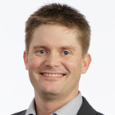

President’s
Welcome
Chapter Executive Committee
David Chapman
Chapter President

Slide 4
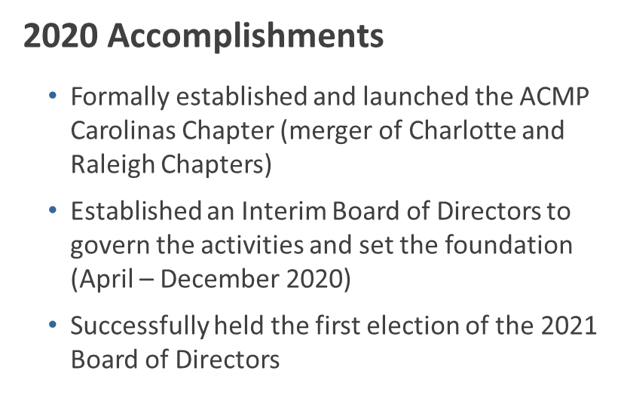
2021 Strategic Goals
Improve the operations and future sustainability of the ACMP Carolinas Board of Directors to ensure the board and all committees will increase the value of the chapter to its members, sponsors and contacts. We will focus on:
  Operational stability
  Financial responsibilities
  Board succession planning
  Community engagement
  Increase membership and participation
  Focus on diversity, equity, and inclusion in everything we do

Slide 5

SPONSOR
SPOTLIGHT

Slide 6





SPONSOR SPOTLIGHT
iTalent Digital is an innovative, woman-and minority-owned, global SaaS software and consulting company headquartered in San Jose, California. We are committed to helping companies achieve exceptional business outcomes through a robust suite of digital transformation capabilities, services, microservice and dynamic product solutions.
Services
AI: ML and Process Re-engineering
Change-as-a-Service (CaaS)
Big Data: Business Insights and Analytics
Enterprise Content and Collaboration
Digital Transformation - Agile Program Management
Cloud Integration and Software Development
Accessibility UI
Personalization & Unified Search
Managed Dev Ops Services
Managed Service Operations
Technical, Engineering and Enterprise Staffing
SaaS Products
Intelligent Recruiting Platform (MojoRank™)
Digitized Change Management (Chama™
Intelligent Content Syndication™ (ICS)
https://www.italentdigital.com
Notes:
Austin, TX
London, UK
Dublin, Ireland
Hyderabad, India
RTP, NC
Seattle, WA
Hong Kong
Krakow, Poland
Guadalajara, Mexico

Slide 7
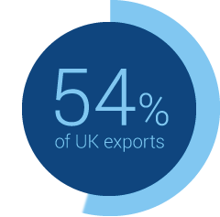


Unique Perspectives through Diversity
54%
Women
59%
Minority
Certified Woman-Owned AND Certified Diverse Supplier
Winner of 2020 Responsible Procurement Award
Recipient of Cisco’s first ever Supplier of the Year award in the ‘Diversity’ category (2016)
First Diverse Supplier to also become a Cisco “Preferred” Supplier.
Cisco has nominated iTalent Digital for WRMSDC’s (Western Regional Minority Supplier Development Council) prestigious Supplier of the Year Award

Slide 8




















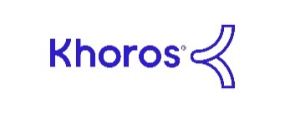





Some of the Leading Brands We Work With
Some of the Clients we work with…
Some of the Partners we work with…

Slide 9
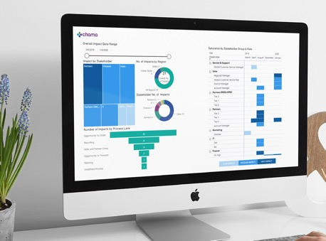

What is Chama?
Chama =
Change + Management
Chama™ is cloud-based technology that enables companies to achieve exponential change and continuous learning through data-driven insights across projects, programs, and portfolios.
Chama is a highly flexible and adaptive tool that is compatible with any CM framework you may be using.
The Chama™ platform enables you to prepare, equip and support your people so they can fully and sustainably engage in driving your organization’s success.
Notes:
Chama™ is the cloud-based technology that enables the delivery of Change as a Service (CaaS) for companies to achieve exponential change and continuous learning through data-driven insights across projects, programs, and portfolios.
Chama™ enables you to elevate transformational change management from the project to the enterprise level.
Your organization changes every time it solves a new problem, enters a new market, adopts a new technology, responds to a new industry trend, embraces a new opportunity, or updates a strategy. This constant change affects how your people do their jobs - and your people are the single most important driver of your company’s success!
The Chama™ platform enables you to prepare, equip and support your people so they can fully and sustainably engage in driving your organization’s success.

Slide 10

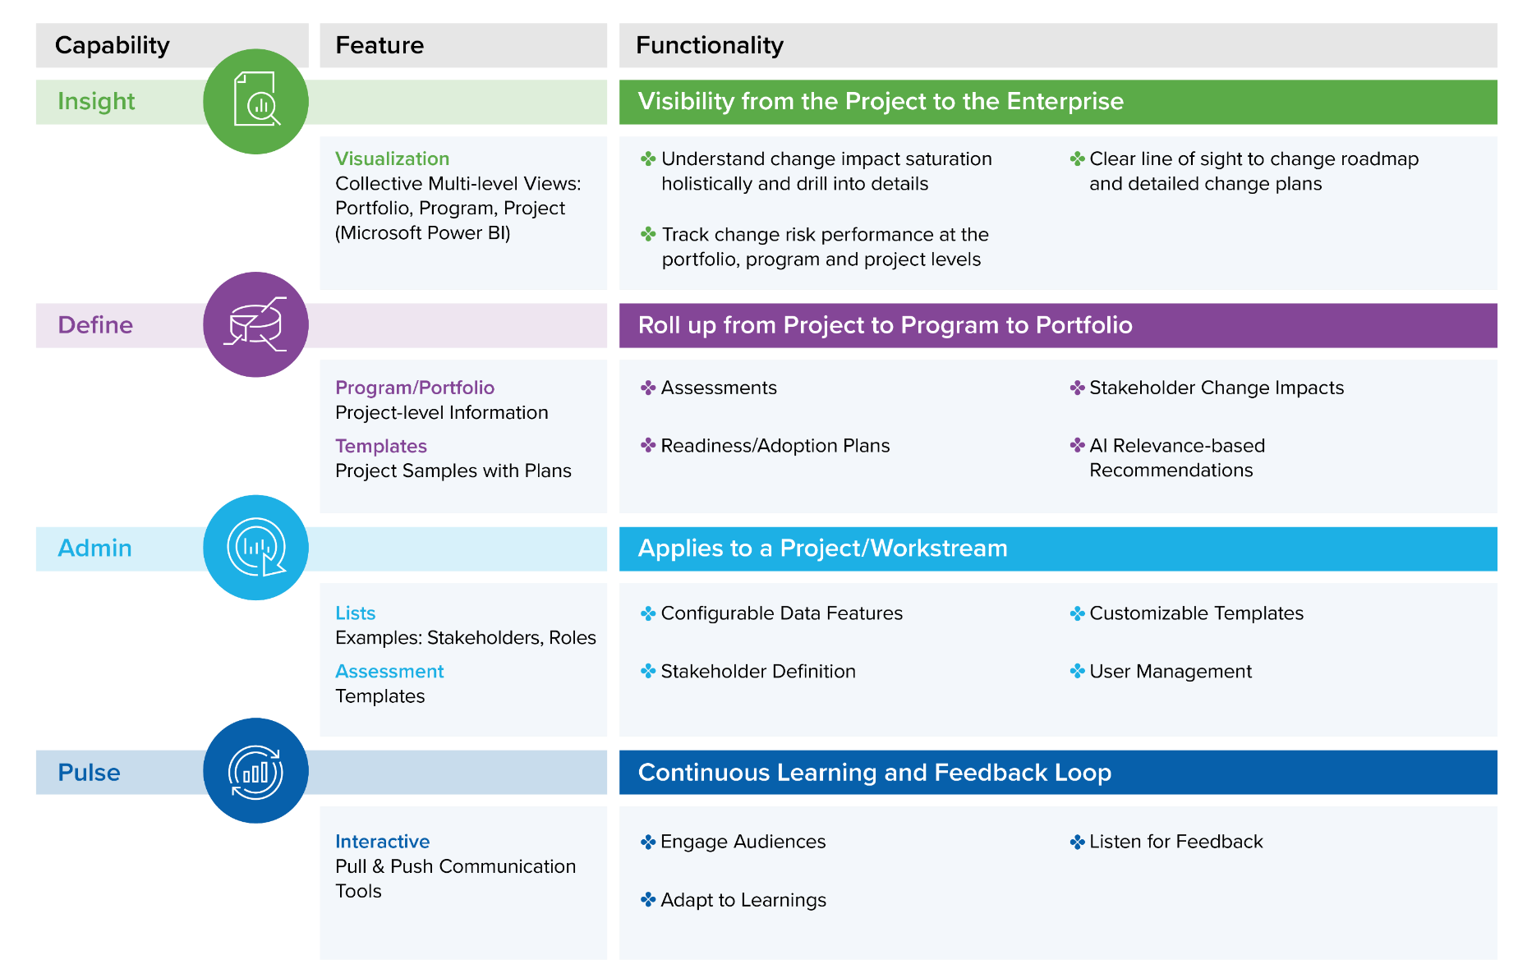
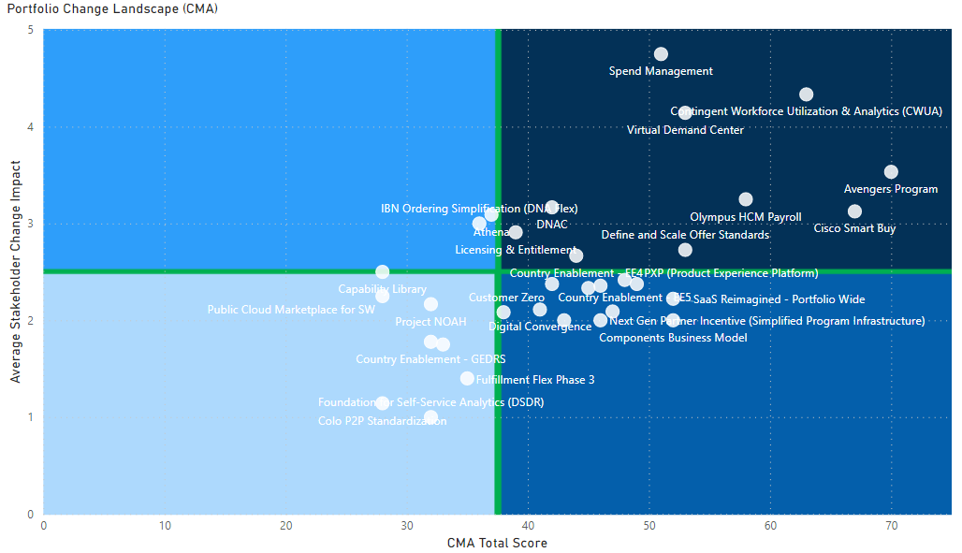
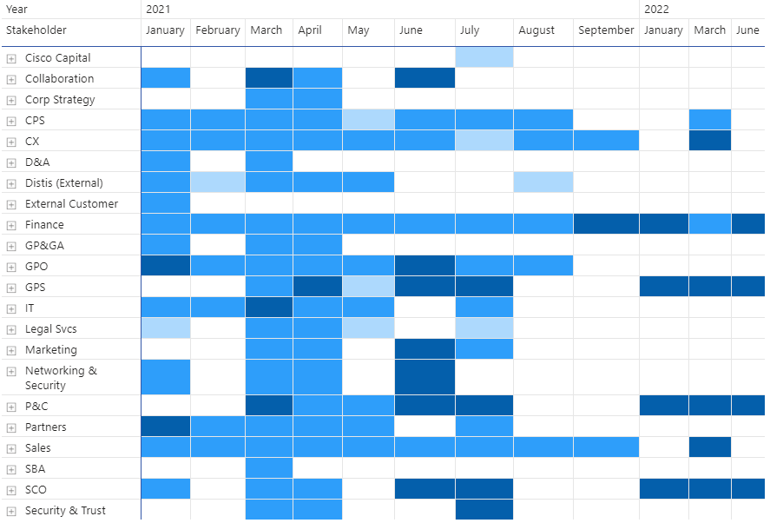
How Key Capabilities Deliver Strategically
Integration of Portfolio and Change from the project to the enterprise level with any framework
Change Portfolio Landscape
Change Saturation
https://www.chamacloud.com

Slide 11


Girls Leadership Academy Meetup
​ #OneMillionGirlsBy2030 - GLAM has joined the "Decade of Action" and we made the commitment to reach and empower 1 MILLION GIRLS BY 2030.
​
#1000WomenInSTEM - We believe girls can be limited by a lack of visible female role models. That’s why we made the commitment to showcase 1000 WOMEN IN STEM BY 2030.
Two-Time Stevie™ Award Winner
2016 - Event of the Year
2018 - Community Involvement Program of the Year
https://www.glam-readytolead.com
Notes:
WE equip girls across the globe with the skills and confidence to seek leadership roles, feel power within their voice, and create positive change in the world.
​
WE envision a world where all girls and young women feel empowered and supported to reach their fullest potential, regardless of socio-economic circumstances.
Girls Leadership Academy Meetup Launched in June 2016, equipping girls ages 8 -12 with leadership skills and the confidence to pursue careers in tech.

Slide 12
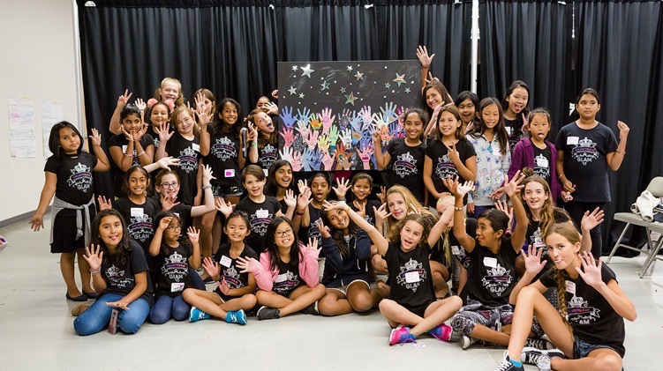
Transforming GLAM – Going Virtual
Immersive Events
Delivering at Scale - In 2021 GLAM has gone virtual and will be seeking to multiply our reach and impact alongside launching new initiatives and engaging content on our GLAMSquad pages, featuring content tailored for girls.
​
GLAM Virtual is delivered in collaboration with our corporate partners through funding and guest speakers. Talk to us today about how we can deliver a GLAM Virtual with you, and together we can reach and empower more girls around the world to be the trailblazers of tomorrow.
Going Virtual!
Three 90-minute sessions over a 3-week period, then in week 4 prepare business plan pitches
260 Girls at GLAM Live
5 Immersive 2-Day Camps
25 %
from underserved backgrounds
https://www.glam-readytolead.com
Notes:
4 US, 1 UK
Delivering at Scale - In 2021 GLAM has gone virtual and will be seeking to double our reach and impact alongside launching new initiatives and engaging content on our GLAMSquad pages, featuring content tailored for girls.
​
GLAM Virtual is delivered in collaboration with our corporate partners through funding and guest speakers. Talk to us today about how we can deliver a GLAM Virtual with you, and together we can reach and empower more girls around the world to be the trailblazers of tomorrow.
Hard to make girls sit at a computer all day so we did three 90-minute sessions over a 3-week period, then in week 4 they prepared their business plan pitches
225 women have now completed the Superpower profile and 75 girls have taken the superpower quiz

Slide 13
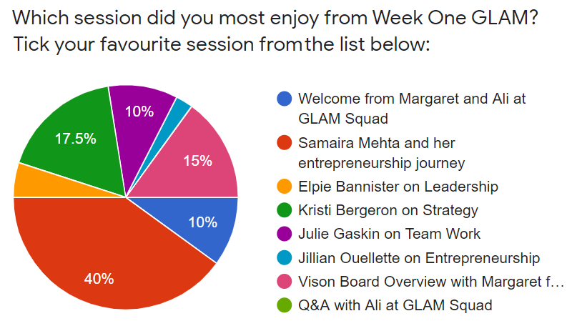
GLAM VIRTUAL - The Pilot
Feedback:
I really enjoyed the strategies that we could put into action. I also loved the mood board activity.
I liked the vision board activity and am making it now!
I wasn't expecting it to be this good - looking forward to coding.
I love it.
Everyone was friendly and helpful, and I really enjoyed it! :)
I loved GLAM because it motivates Girls to Dream Big and be successful.
It was very inspiring, and I think it was awesome. I am very excited for week two.
It was all brilliant!
I loved week one of GLAM! It was really well organized, and I learned loads and thought some of the videos we watched were really inspiring
Demographics
58 Girls
13 USA
45 UK

Slide 14
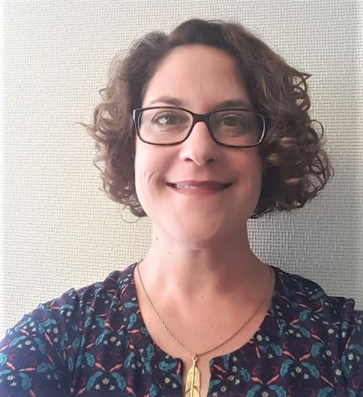
TREASURY
UPDATE
Julie Gawle
Treasurer

Slide 15


ACMP Carolinas Financial Update
April 1 – December 31, 2020
CHAPTER
FINANCIALHEALTH
NET INCOME
$17,711
177
MEMBERS SERVED
18
EXPENSES
$3,339
ONLINE
EVENTS

Slide 16
2021-2022
Sufficient funds to meet all annual expenses
Partner with Committees
Serve our Members
Save for the Future
Financial Goals

Slide 17
Membership Committee
Mission:
To provide ACMP Carolinas Chapter Members a sense of belonging.

Slide 18
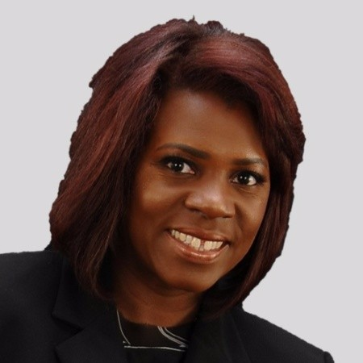
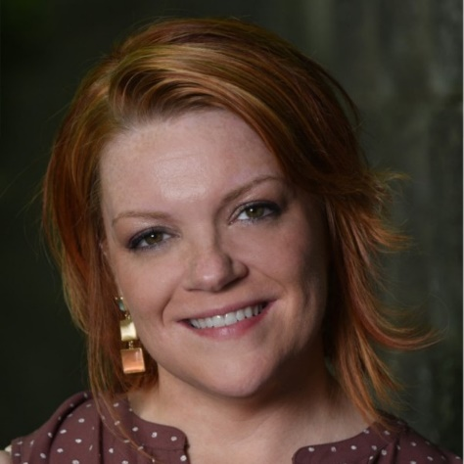
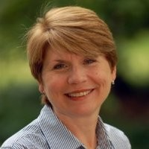
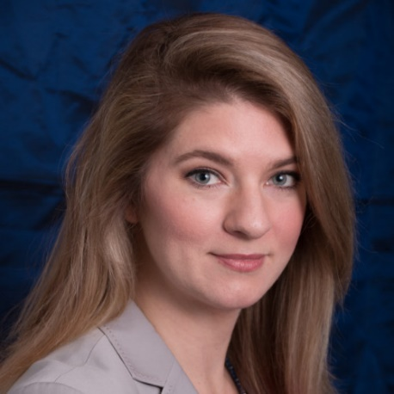
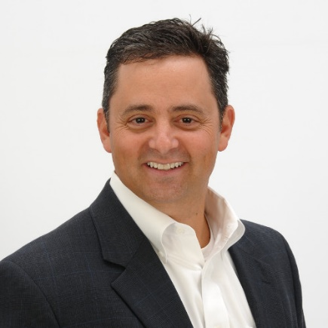
Membership Committee
Lalonna Griffin, QPCR
Alfred Williams Co.
Leslie Ellis, CCMP
Involved Change, Inc.
Sandra Bobbitt
Herman Miller, Inc.
Sarah Lowe
Evans Inc.
Committee Chair
Chris LaPata, MCR
BHDP Architecture

Slide 19
Membership Committee
By the numbers…
2:1
177
19
10%

Slide 20
Membership Committee
Welcome…
New Members as of January 1, 2021

Slide 21

Membership Committee
2021 KEY STRATEGIC OBJECTIVES:
Establish Quarterly Member Chapter meeting
Develop, administer, analyze and share member survey result by end of Q3
Plan and Execute Membership Drive by Q3
Recruit and grow membership committee to (10) members by Q4
Work with Programs Committee to establish “Community Reinvestment” Sub-Committee (Quarterly Sweat Equity events)

Slide 22
Membership Committee
STRATEGIC OBJECTIVE:
Community Reinvestment Committee
Mission: Create opportunities for ACMP members of the Carolinas Chapter to support the communities where they work and live.
How: The Community Reinvestment Committee will: Communicate and build awareness of the needs with non-profit agencies in the community.
Post-COVID plan volunteer “sweat equity” events.
Examples include sorting food at Feeding America Food Bank, sorting school supplies, provide labor at a Habitat for Humanity build, etc.

Slide 23
Membership Committee
STRATEGIC OBJECTIVE:
Community Reinvestment Committee
Pillars of Need to Support: Basic needs of Hunger, Housing, Children & Education:
Children & Education: Support agencies and organizations with a mission to provide services to children in need because of health issues, living in poverty and any situation that leaves them at risk.
Housing:
Support agencies in the Carolinas with the mission to provide housing and shelter for those in need with donation opportunities and sweat equity / volunteer hours.
Hunger:
Support the Food Banks in the Carolinas with the donation of food, money & sweat equity / volunteer hours

Slide 24

Membership Committee
STICK AROUND !!!
One lucky member will WIN
an all expenses paid admission to…
June 8 — June 11, 2021

Slide 25
Membership Committee
Interested in joining the membership committee?
Please contact:
clapata@bhdp.com
Thank you !

Slide 26

BREAKOUT ROOMS: Tell us a little something about yourself …
  What’s your name?
  What company are you with?
  When did you join ACMP? And WHY?
  Tell us a little more …
What’s your favorite thing about your home office?
Pick 1
Where do you want to go when the pandemic is over?
What’s the funniest thing one of your pets has ever done?

Slide 27
And….
WE’RE BACK…

Slide 28
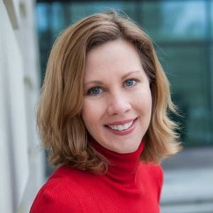
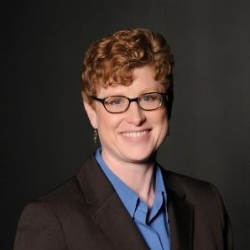
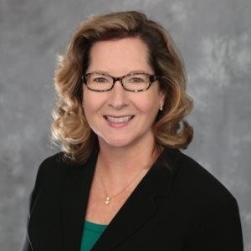
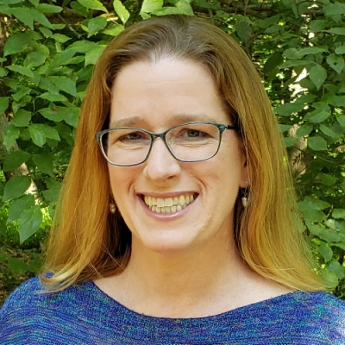
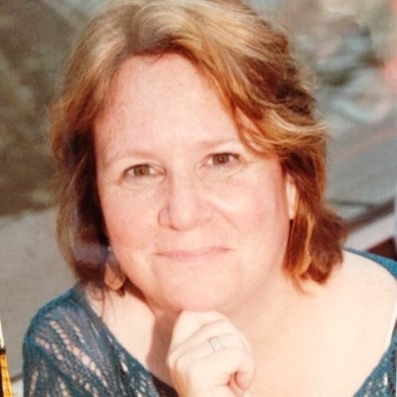
Meet the Sponsorship Committee
Christian Swain
Cassandra Willis
Leslie Ottavi
(chair)
Heather Marks
Lisa McRoberts

Slide 29




Thank You ACMP Carolinas Sponsors!
241% of goal for 2020!
Know someone who would be interested in sponsoring our chapter?
Learn more about our sponsorship program at:
Contact: leslie.ottavi@acmpcarolinas.org
https://www.acmpcarolinas.org/OUR-SPONSORS

Slide 30
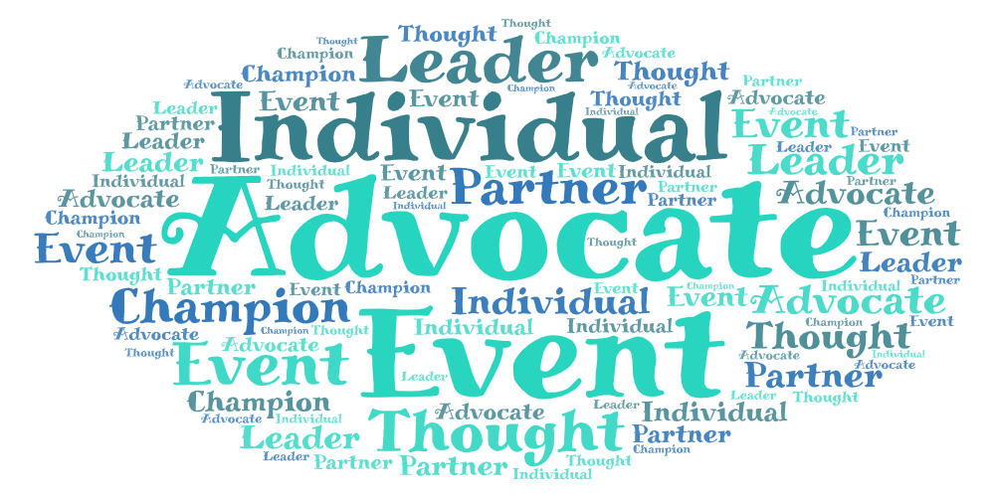
Sponsor Types
Top Four Reasons for You or your Organization to Become an ACMP Sponsor
Your tax-deductible donation will provide the following benefits for your organization: Access to Local Change Professionals Expanded Brand Visibility Industry Leadership Community Support The ACMP Carolinas Chapter relies on sponsor donations to advance the capabilities of local change management practitioners through education, networking, and professional development. We appreciate event, annual, and individual sponsorship.
Notes:
Your tax-deductible donation will provide the following benefits for your organization.
Access to Local Change Professionals – Gain exclusive access to active change management professionals who live and work in North and South Carolina. Discover your next great connection by getting to know our member experts and the services they can provide.
Expanded Brand Visibility – Build awareness and loyalty for your products and services with our members and the companies in which they work. Raise your profile with a naturally curious audience dedicated to helping individuals’ experience change and improving organizational culture.
Industry Leadership – Target a niche audience that’s engaged in finding the best and most effective products and services to accelerate change. Generate business opportunities with potential clients who understand what it takes to facilitate change within complex organizations.
Community Support – Demonstrate your commitment to helping people of all walks of life transition through change with the expert guidance of a change professional.
The ACMP Carolinas Chapter relies on sponsor donations to advance the capabilities of local change management practitioners through education, networking, and professional development. We appreciate event, annual, and individual sponsorship.

Slide 31
Sponsorship Strategic Objectives for 2021
FY21 Establish our Sponsorship program processes Create framework to gain feedback from Sponsors Grow the number of annual and event sponsors to advance our chapter’s capabilities for the Carolinas change management profession STRETCH GOALS: Partner with select community and educational institutions to drive more diversity, equity and inclusion in our chapter and profession Create an initiative to engage Members and Sponsors in giving back to the local community FY22 and Beyond Establish and evolve best practices that are documented and shared with our ACMP global community Partner with our Sponsors to conduct white paper research and publish case studies on innovations in change management
Notes:
Future State:
Active local community sponsors and partners engaged with the chapter events, ACMP research and leveraging our chapters resources to better their own change management practices.
Sponsorship program continuous to evolve as we listen, evaluate and adapt to the needs of the members and sponsors.
Thriving sponsorship committee engaging and collaborating to improve our mature processes, agreements, levels & benefits, while ensuring transparency.
FY21
Establish our Sponsorship program processes that incorporate collaboration between the Events, Sponsorship and Marketing & Comms committees
Create framework to gain feedback from Sponsors on what benefits them most by associating with ACMP or what would help the Sponsors achieve their objectives
Grow our number of annual and event sponsors that advance the chapter’s capabilities for the Carolinas change management profession
STRETCH GOALS:
Partner with select community and educational institutions that complement or promote the change management profession to bring awareness of what this skill set does and encourage diversity, equity and inclusion
Create an initiative to engage Members and Sponsor in giving back to the local community
FY22 and Beyond
Establish and evolve best practices that are documented and shared with our ACMP global community.
Conduct “white paper” series with our Sponsors on change innovations to further how companies, institutions and communities can increase their change agility and resiliency

Slide 32
Sponsorship Committee
There are many ways you can help!
Become a sponsor yourself
Join a sub-committee to:
  Identify and contact potential sponsors
  Define and document processes
  Gather and analyze sponsor feedback
Contact Leslie at:
Leslie.ottavi@acmpcarolinas.org

Slide 33
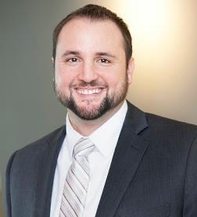
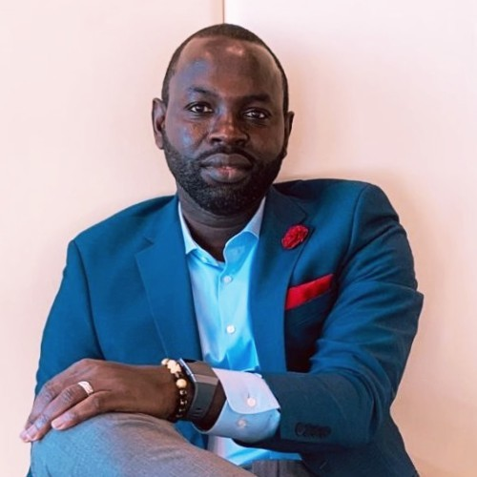
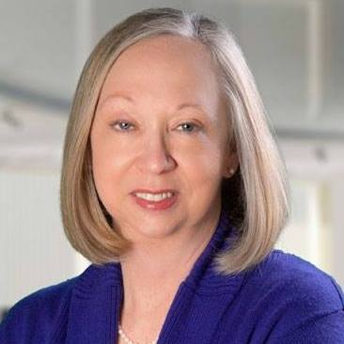
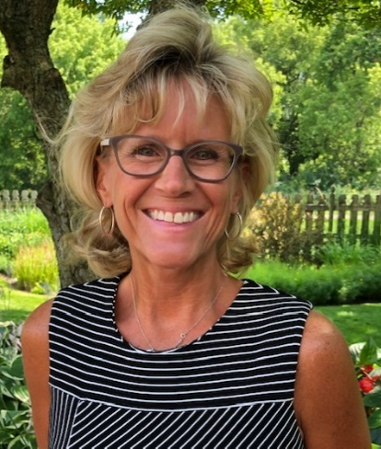
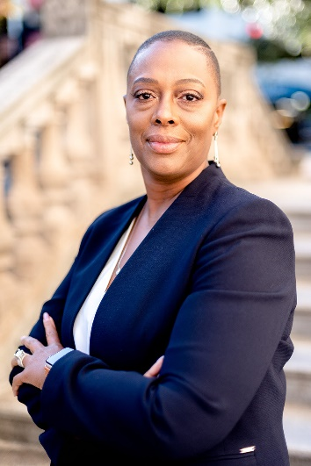
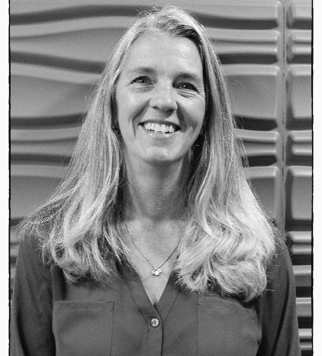
Programming & Events
Small But MIGHTY!
Committee Chair
Aaron Stroud
Cisco
Beth Britt
Ashlin Associates
Ibrahima Kourouma
Rosalind Tyburski
Volvo Grp Trucks Ops
Kim Kolar
Cara Group, Inc.
Shirell Edmonds
Athena Health
* Not pictured Matt Humer

Slide 34
Programming & Events
We Did It…
18 virtual events in 9 months as part of the “Change From Home” Series
Hosted discounted Prosci event
Led CCMP Office Hours
Facilitated 2 virtual Happy Hours
Partnered with 4 organizations
Hosted 10 guest speakers
Organized a Book Club
ACMP

Slide 35
Programming & Events
What We Will Do…
This year we are even more focused on quality and hope for in-person!
Hold 13 events by the end of 2021
Standardize all internal processes by July
Complete & implement insights dashboard by May
Attain sponsors for 40% of events
Avg. 50 attendees for each major event in 2021
If you want to see something, say something!
Email aaron.stroud@acmpcarolinas.org

Slide 36
Programming & Events
Join Us!
Learn More: aaron.stroud@ACMPCarolinas.org
Investment:
Hour meeting once every 2 weeks
Approx. hour of work every 2 weeks, doing whatever it is you want to do!
Pay Off:
Play an active role in Program design & delivery
Be part of an excited and fun Team!
Gain exposure and build your network
Immortality!
ACMP

Slide 37

Programming & Events
Upcoming Events:
Fireside Chat:
PMI Collab #1: The Intersection of Project Management & Org CM
Prosci VIRTUAL Change Management Certification (FULL)
PMI Collab #2: The Power of Partnership
ACMP Merger Member Celebration (NOW!)
PMI Collab #3: Learning the Success in Your Failures 3/16
Book Club: Lean CM: Innovative Practices For Managing Org Change 3/30
TBD: Neuro Leadership in CM – Details TBD
For updated listings of events go to: https://www.acmpcharlotte.com/Events
ACMP

Slide 38
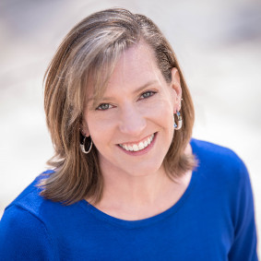
Communication Committee
Update
Kendra Whitney
Communication Committee Chair

Slide 39
Marketing and Comms Committee
Objective:
To support the goals and objectives of the chapter of increasing the value to the members, sponsors and contacts. The Marketing and Comms Committee will focus on driving up attendance of events, supporting our sponsors, increasing membership and engaging our members.

Slide 40
Marketing and Comms Committee
Natasha Carter
Lara Chatterley
Teresa Ann Fabiano
Robin Hyatt
Kendra Whitney - Committee Chair

Slide 41
Marketing and Comms Committee
2021 KEY STRATEGIC OBJECTIVES:
Focusing on systematizing and operationalizing multiple standard marketing analytics* using Google and LinkedIn analytics to measure the success of marketing effort, conversion, efficiency, impact, and growth for our chapter including: campaigns, events, training, education, and membership engagement.
Developing a streamlined internal marketing team infrastructure that clearly defines roles and accountabilities. Developing and documenting marketing processes so they are turn-key for any successors.
Continuing to work on the Chapter’s Brand Architecture by identifying our target users, creating a cohesive brand (voice, tone, messaging, imagery, font, colors) and guide that will be used for all ACMP Carolinas communications.

Slide 42
Marketing and Comms Committee
Do you have marketing experience?
Are you a social media expert?
We are looking to grow our committee!
Please contact:
Kendra Whitney

Slide 43
Chapter
Awards

Slide 44
THE WINNER!
All expenses paid admission to…
A $500.00 VALUE
June 8, — June 11, 2021

Slide 45

2020 Board Member of the Year
And the winner is…

Slide 46

2020 Volunteer of the Year
Congratulations to…
Robin Hyatt

Slide 47
2020 Volunteer of the Year
Congratulations to…
Kim Kolar

Slide 48

THANK YOU FOR ATTENDING !
Mark your Calendar
Next Member meeting
Wednesday - June 2, 2021 12 noon – 1pm

Slide 49
Thank you!
THANK YOU FOR ATTENDING !
Mark your Calendar
Next Member meeting
Wednesday - June 2, 2021
12 noon – 1pm

